Slide 1
Compile.io
Developers: Mike Riley, Joshua Palamuttam, Zachary Foote, Zachary Thelen
Sponsors: Sam Pastoriza, Donald Sisco, James Edwards

Slide 2
What is Compile.io?
Compile.io is a web-based application for students and professors to be used as a central system for all CSSE courses at Rose-Hulman. Students are able to submit code that will be compiled and have tests ran on it with quick feedback for the student and ease of grading for the professor.

Slide 3
Features
Students can submit code in multiple languages to a server and receive feedback.
Professors can configure homework assignments
The system is scalable to handle multiple classes worth of submissions at a time.
System uses Authentication through RoseFire

Slide 4
Challenges
Development with tools the team hasn’t used before.
Getting JUnit to work inside of Docker and be flexible
Finding the right Gradle dependencies within Spring and Docker

Slide 5
Description of Tools used
Angular
Spring
Docker
MongoDB
Java
GitHub
*have the logos of all the things we used somewhere on the poster

Slide 6
UML
https://drive.google.com/open?id=1oIlOvuC8F1-KKF40hXINUudH0zfVrF5H

Slide 7
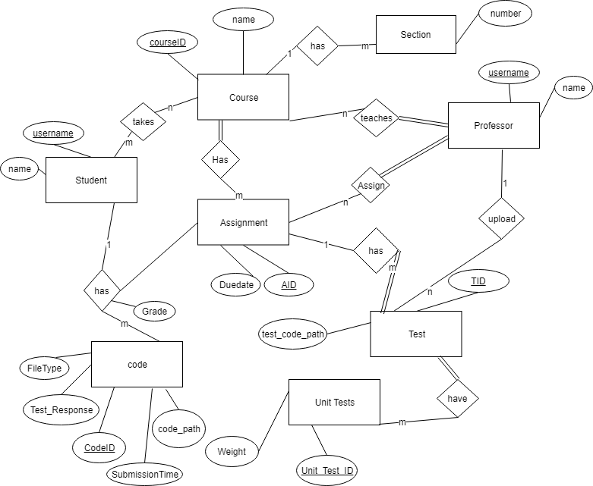
ER Diagram

